Slide 1
Risk And Return

Slide 2
Risk And Return of A Single Asset
Rate of Return
The Rate of Return on an asset for a given period is defined as follows:

Slide 3
Risk And Return of A Single Asset
Consider the following information about a certain equity stock.
Price at the beginning of the year | Rs 60.00
Dividend Paid at the end of the year | Rs 2.40
Price at the End of Year | Rs 69.00

Slide 4
Risk And Return of A Single Asset
The Rate of Return on this stock is calculated as follows

Slide 5
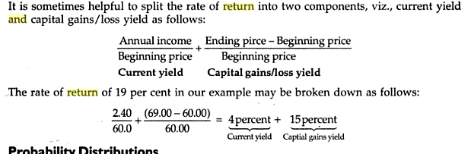
Risk And Return of A Single Asset

Slide 6
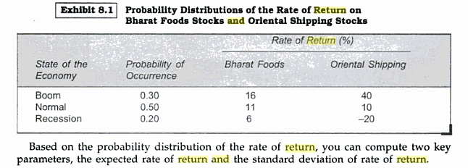
Rate of Return
Rate of Return

Slide 7
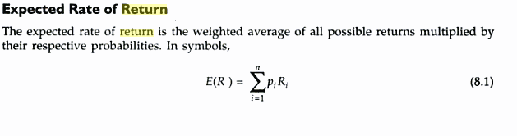
Expected Rate of Return

Slide 8
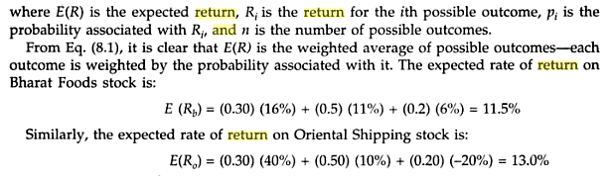
Expected Rate of Return

Slide 9
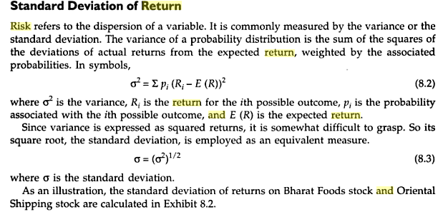

Slide 10
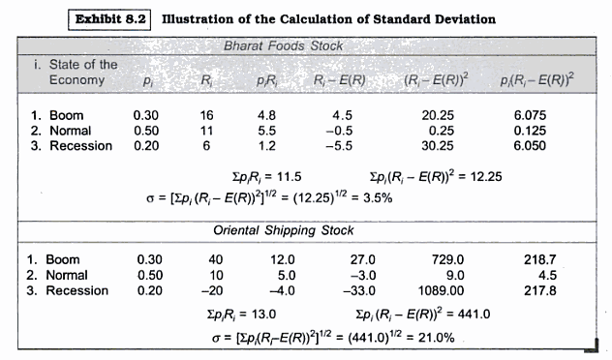

Slide 11
Continuous Probability Distribution
The probability distribution of returns on Bharat Foods Stock or Oriental Shipping stock is a discrete distribution.
In finance, however, probability distributions are commonly regarded as Continuous
Probabilities are assigned to intervals between two points on a continuous curve.
Hence when a continuous probability distribution is used, the following kinds of questions are answered: What is the probability that the rate of return will fall between 10% and 20%.
What is the probability that the rate of return is less than 0 percent or more than 25 %

Slide 12
Example : Consider a portfolio consisting of two securities, A and B. The expected return on these two securities are 10 percent and 18 percent respectively
The expected return on the Portfolio, when the proportions invested in A and B are 0.4 and 0.6 is

Slide 13
When a Portfolio consists of n securities

Slide 14
Example: Consider a Portfolio consisting of five securities with the following expected returns
 | %
E ( R1) | 10
E ( R2) | 12
E ( R3) | 15
E ( R4) | 18
E ( R5) | 20

Slide 16
Diversification and Portfolio Risk
Suppose you have Rs 100,000 to invest and you want to invest equally in to stocks A and B. The return on these stocks depends on the state of the economy.
State of the Economy | Probability | Return on Stock A (%) | Return on Stock B(%) | Return on Portfolio (%)
1 | 0.20 | 15 | -5 | 5
2 | 0.20 | -5 | 15 | 5
3 | 0.20 | 5 | 25 | 15
4 | 0.20 | 35 | 5 | 20
5 | 0.20 | 25 | 35 | 30

Slide 17
Expected Return and Standard Deviation

Slide 19
WHAT HAPPENS IF YOU INVEST IN A PORTFOLIO CONSISTING OF STOCKS
A AND B IN EQUAL PROPORTIONS
WHILE THE EXPECTED RETURN REMAINS AT 15 %, THE SAME AS THAT OF EITHER
STOCK INDIVIDUALLY, THE STANDARD DEVIATION OF THE PORTFOLIO RETURN,
9..49, PERCENT IS LOWER THAN THAT OF EACH STOCK INDIVIDUALLY. THUS IN THIS
CASE DIVERSIFICATION REDUCES RISK.

Slide 20
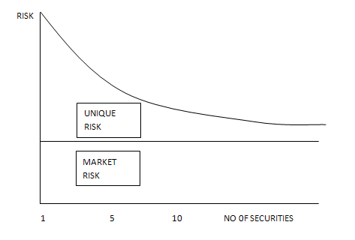
Relationship Between Diversification and Risk

Slide 21
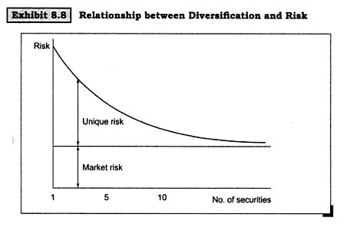
Relationship Between Diversification and Risk

Slide 22
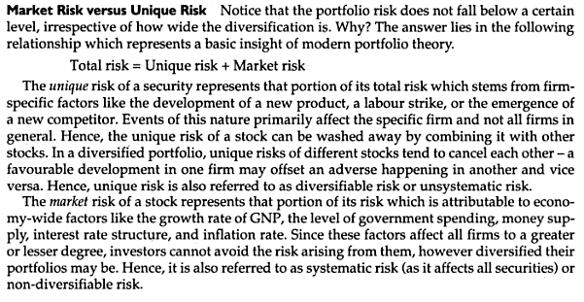

Slide 23
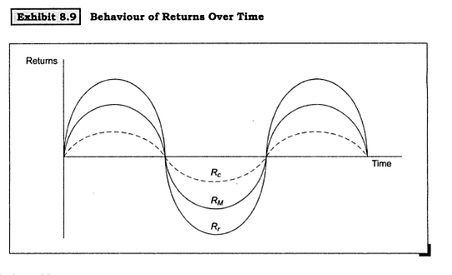
MEASUREMENT OF MARKET RISK
The market risk of a security reflects its sensitivity to market movements

Slide 24
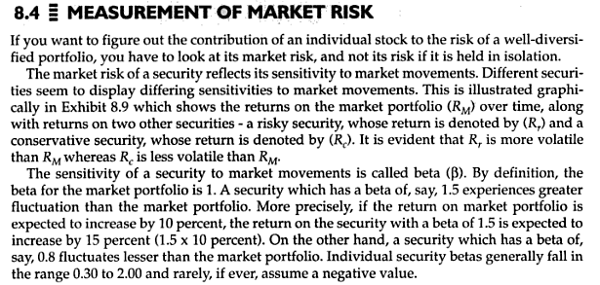

Slide 25
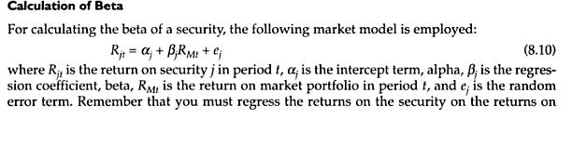
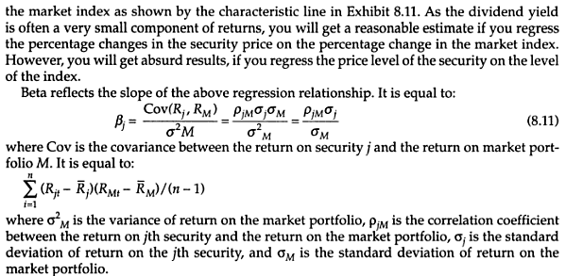

Slide 26
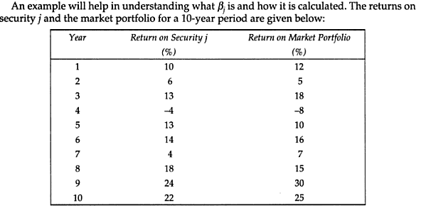

Slide 27
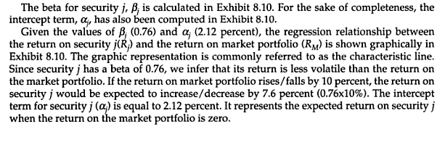

Slide 28
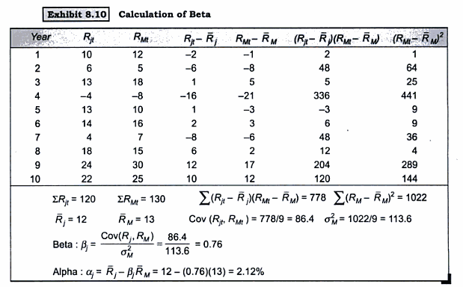

Slide 29
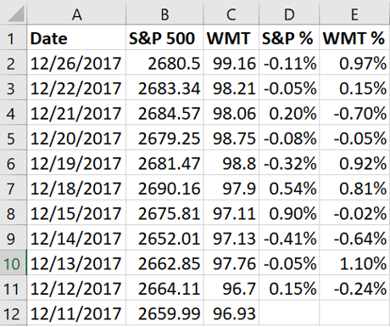

Slide 30
Copy both of the closing price columns into a new spreadsheet. They should be in order from newest to oldest. To obtain the correct format for calculation we must convert these prices into return percentages for both the index and the stock price. To do this, just take the price from today minus the price from yesterday and divide the answer by the price of yesterday. The result is the percentage change. Below is an example showing this in Excel.

